Slide 1
Cosa c’è di nuovo in chirurgia d’urgenza – Ischemia Mesenterica (Acuta)
Prof. MARIO D’ORIA, md
Sc (uco) CLINICA DI CHIRURGIA VASCOLARE ED ENDOVASCOLARE
Dipartimento di scienze mediche, chirurgiche e della salute, universita’ degli studi di trieste
Dipartimento cardio-toraco-vascolare, azienda sanitaria universitaria giuliano isontina

Slide 2
BACKGROUND
Acute mesenteric ischemia (AMI) is a rare but life-threatening condition with high morbidity and mortality rates despite improvements in surgical and intensive care.
Diagnosis is often delayed due to nonspecific symptoms and, possibly, underestimation of disease prevalence.
Endovascular treatment, which can be carried out through different technical modalities, nowadays offers a minimally invasive alternative to open surgery. Amongst its benefits:
Minimally invasive
Can address multiple vessels during same procedure
Enables real-time assessment of perfusion status before bowel resection
Can address different etiologic forms (embolism, thrombosis, vasospasm)
When successful, may allow to avoid laparotomy or enable limited-extent bowel resection

Slide 3
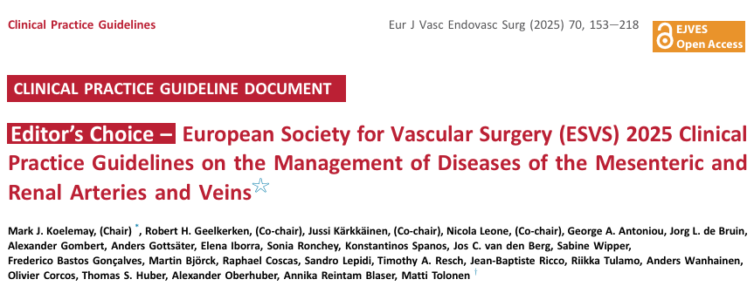
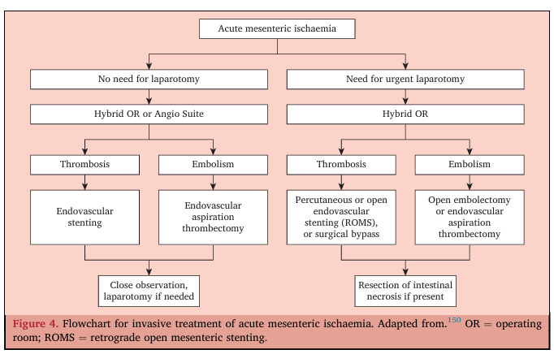

Slide 4
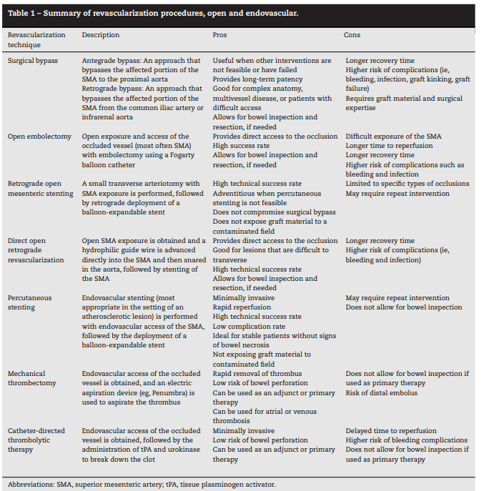

Slide 5
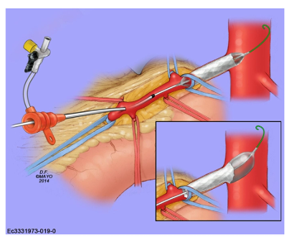
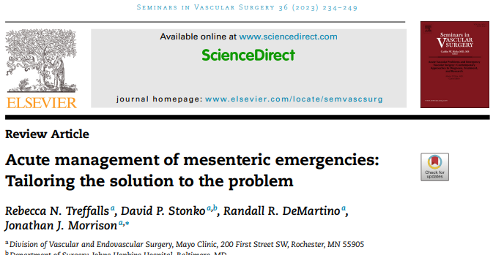
Retrograde Open Mesenteric Stenting (ROMS)
Picture from Treffals et al (Sem Vasc Surg. 2023)

Slide 6
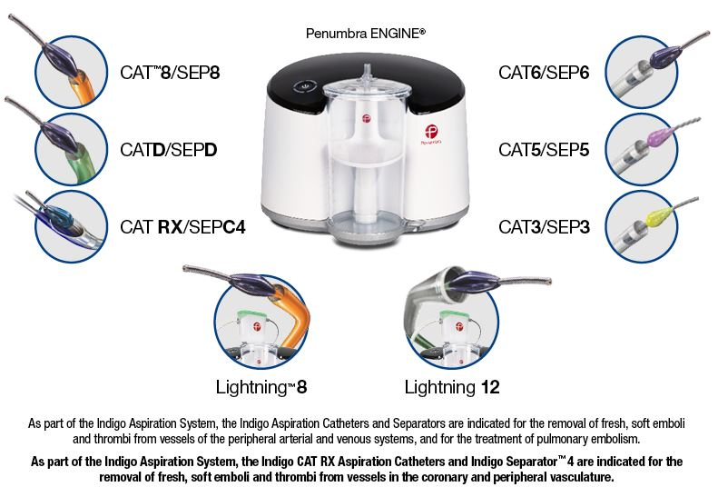
Endovascular Aspiration Thrombectomy (EAT)

Slide 7
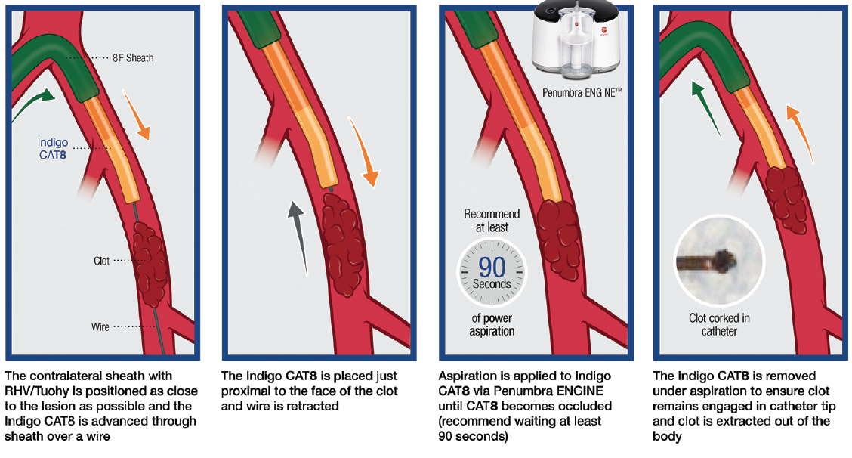

Slide 8
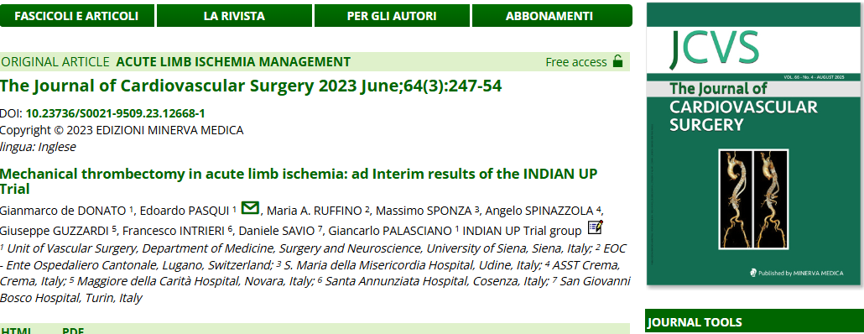

Slide 9
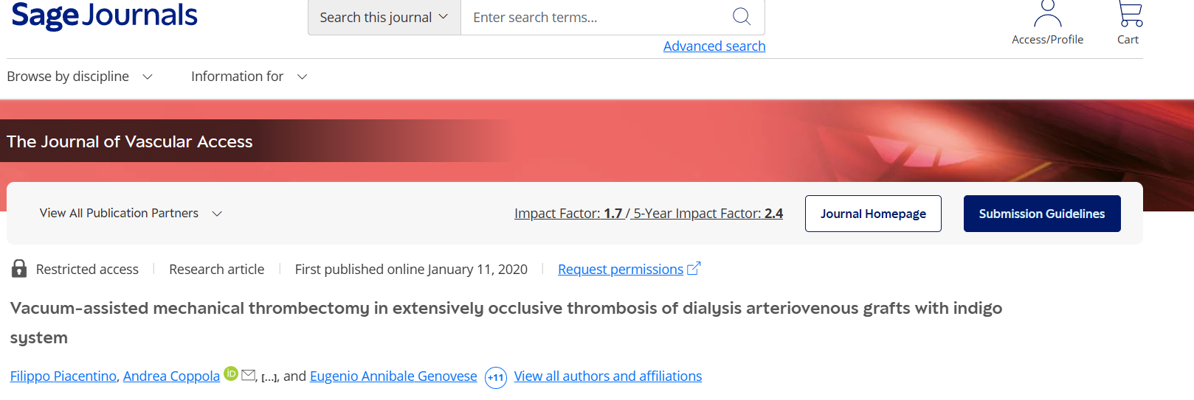

Slide 10
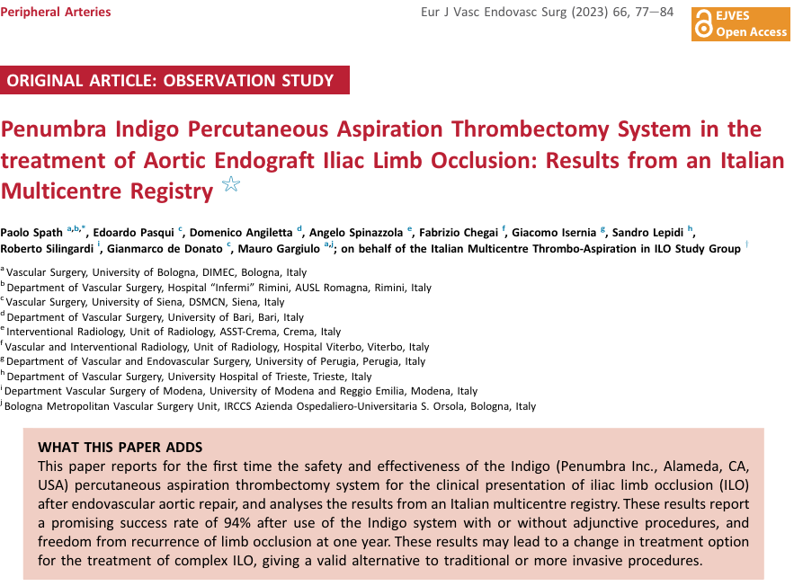

Slide 11


Slide 12
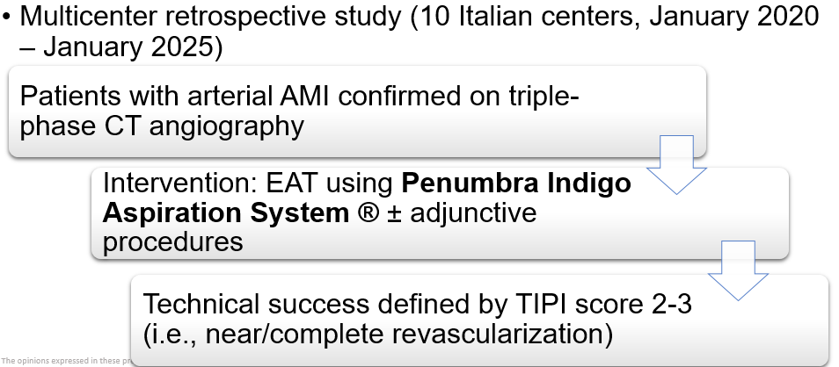
ITALIAN EXPERIENCE

Slide 13
RESULTS
N = 48 patients
EAT alone: 29 pts (60.4%)
EAT + bowel resection: 19 pts (39.6%)
Adjunctive techniques (i.e., thrombolysis, angioplasty, stenting): 32 pts (66.7%)
ICU admission: 31 pts (64.6%)
Median hospital stay: 10 (range 3-20) days

Slide 14
Technical success: 44 pts (91.7%)
Severe complications (i.e., Clavien-Dindo ≥ 3): 58.3% (28 pts)
90-day mortality: 45.8% (22 pts)
86.4% within 30 days
180-day mortality: 72.9% (35 pts)
Early death for all patients without successful revascularization
At multivariate analysis, a procedure longer than 90 minutes (OR=6.3 95% CI= 1.0-37.2; p=.041) and Clavien-Dindo score greater than 3 (OR=19.5 95% CI= 3.2 – 115.5; p=<.001) resulted as independent factors for mortality.

Slide 15
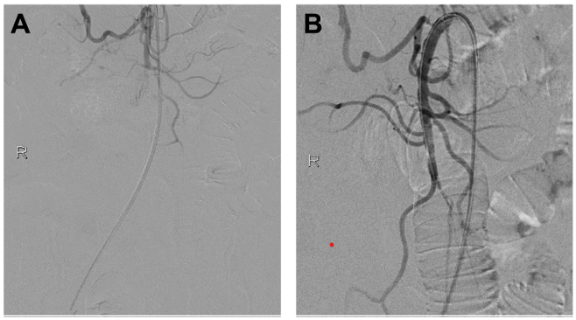

Slide 16



Slide 17
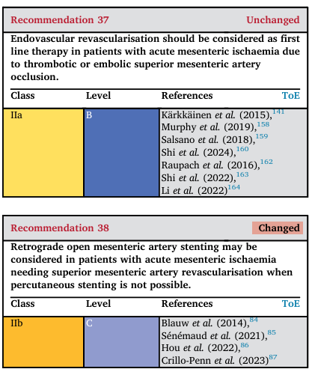
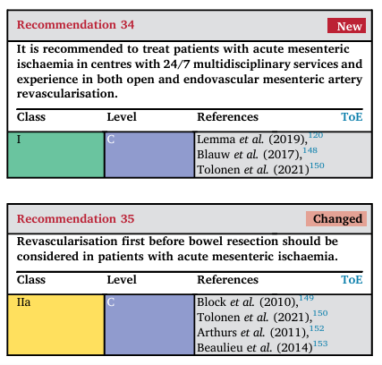

Slide 18
CONCLUSIONS
Endovascular treatment of AMI is safe and effective for many patients and can be seen as first-line modality (in the absence of overt peritonism) where adequate expertise is available.
Amongst available endovascular techniques, EAT is highly feasible and minimally invasive (with option for adjunctive therapies such as in-situ thrombolysis, angioplasty and/or stenting).
High revascularization rates are achieved with the Penumbra system (> 90%). It enables treatment of both EAMI and TAMI, also in challenging scenarios.

Slide 19
CONCLUSIONS
Unfortunately, in-hospital mortality rates remain high, especially due to delayed diagnosis, patients’ comorbidities and disease severity.
High index of suspicion upon ED presentation, early and accurate imaging assessment (i.e. triple-phase thin-slice CTA), and close multidisciplinary collaboration with established pathways of care are needed to establish adequate pathways of care for AMI.
Ultimately, a perfusion-focused initial approach to AMI and selective bowel resection based on severity of peritonism and anatomical knowledge by the provider could improve patient outcomes and reduce mortality.

Slide 20
Grazie per l’attenzione

